Slide 1
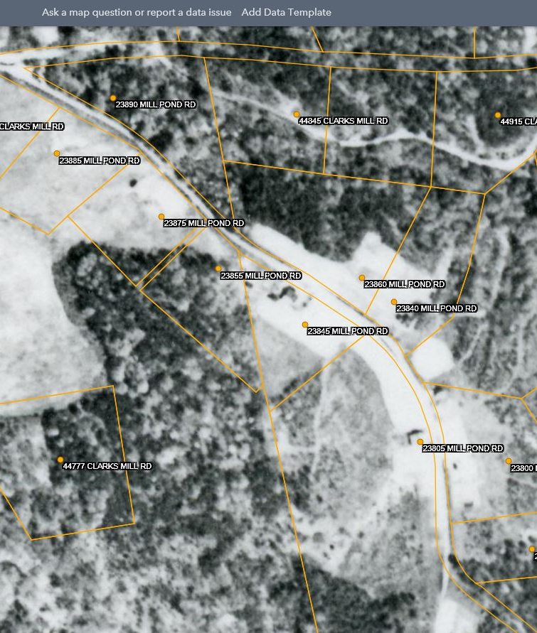

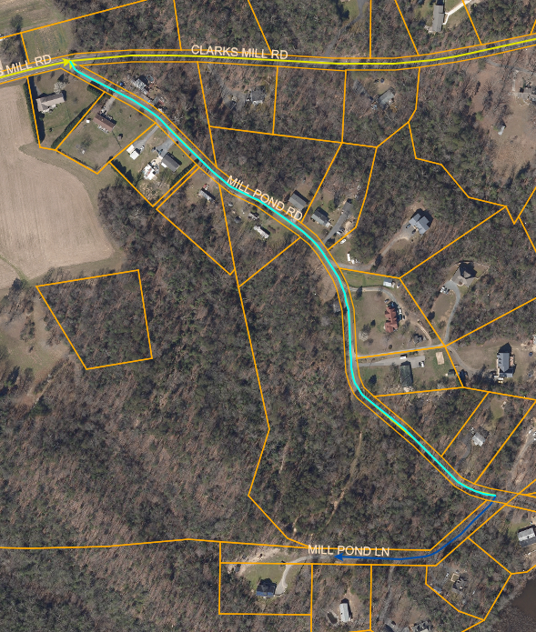
Mill pond road widening project
1938 Aerial Map of Mill Pond Road
2017 Aerial Map of Mill Pond Road
Presentation of the project and citizen engagement
June 2021

Slide 2
Brief Overview
Segments of Mill Pond Road have less than 18’ of pavement width.
The variable width right-of-way makes it difficult to determine the overall impact to the resident’s property.
Our objective is to determine the scope of work area and meet the citizen’s expectations for the project.

Slide 3
Mill pond road has less than 18 feet of pavement width
We understand that in certain sections, the narrow pavement width makes it difficult for two-way traffic to pass by each other.
Large trucks and school buses likely have difficulties with negotiating the road alignment and passing by oncoming vehicles.
While segments of the roadway have been widened, the mid-section has remained substandard in width. This could have been the result of citizen resistance, existing structures, features or the lack of public right-of-way width to accommodate the widening in that area.
Mill Pond Road could be widened to 18 feet of paved surface (Two 9’ travel lanes) for the full length of the roadway.
We expect that the responses from the residents will help us to determine the ultimate solution for the project and we hope to achieve a final design that is amenable to the all the residents along the roadway.

Slide 4
2007 photo of roadway approx. station 9+00
Substandard width is about 11 feet in width

Slide 5
MILL POND ROAD - DRAINAGE
In evaluating the widening of Mill Pond Road, we also need to identify any drainage issues with the current condition of the road.
Solving drainage problems may require using landowner’s property to properly provide a route for draining runoff from the road to s proper outfall area.
We intend that the final design will address any existing drainage conditions as well as any associated with the road widening project.
We look forward to working together in gathering as much information as we can to produce a solution that will be acceptable for everyone.
We would like to avoid conditions like the following:

Slide 6
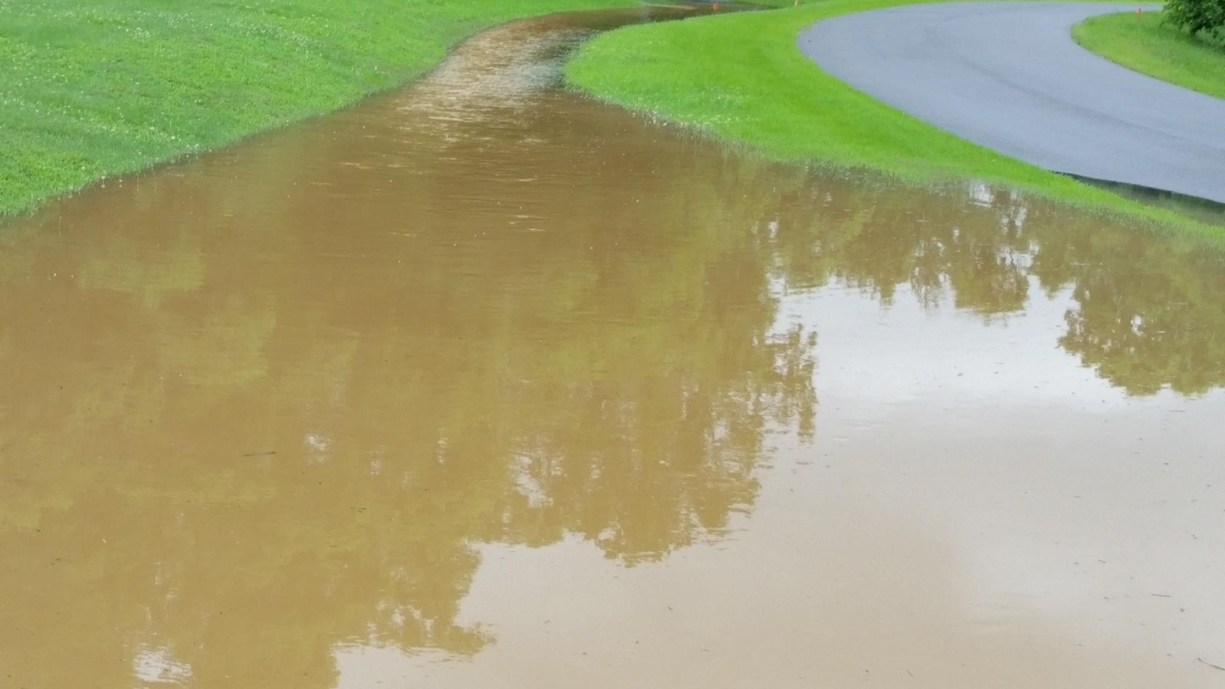

Slide 7
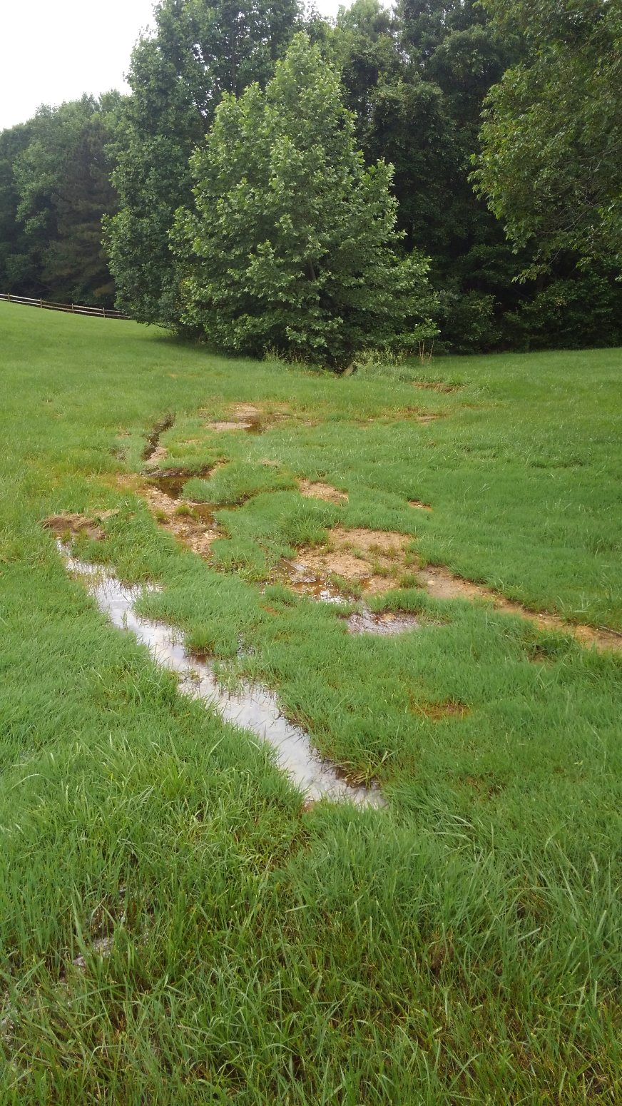

Slide 8
Mill pond road easements
In order to see this project develop, land will likely be needed to widen the road. The land needed for the road widening might be simply an easement but could be as much as a transfer of ownership for a right-of-way. Typically for a County Local Road, the right-of-way is 40 Feet.
Shoulders on the road can be very little or wide enough to support a car going off the road. With wider shoulders and clear zones, vehicle speeds can be noticeably higher than what the community will think is safe so for this project we would aim to keep shoulders to a minimum width of 2 feet.
We are requesting that all residents consider where you would think the future improvements should go in order to meet the needs of this community. Please consider the options of; A)No change at all, B) Provide pull-offs at strategic narrow locations to allow for the passing of vehicle, or C) Full widening of the entire narrow sections.
Each landowner will have a unique situation as it pertains to property or easement acquisitions so identifying which landowners support the project and acquisitions will be helpful.

Slide 9
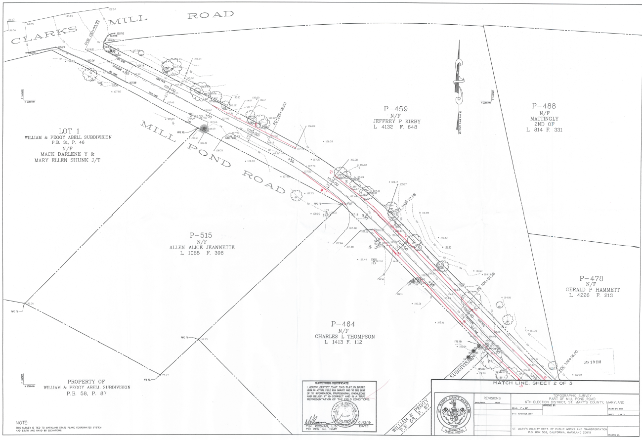

Slide 10
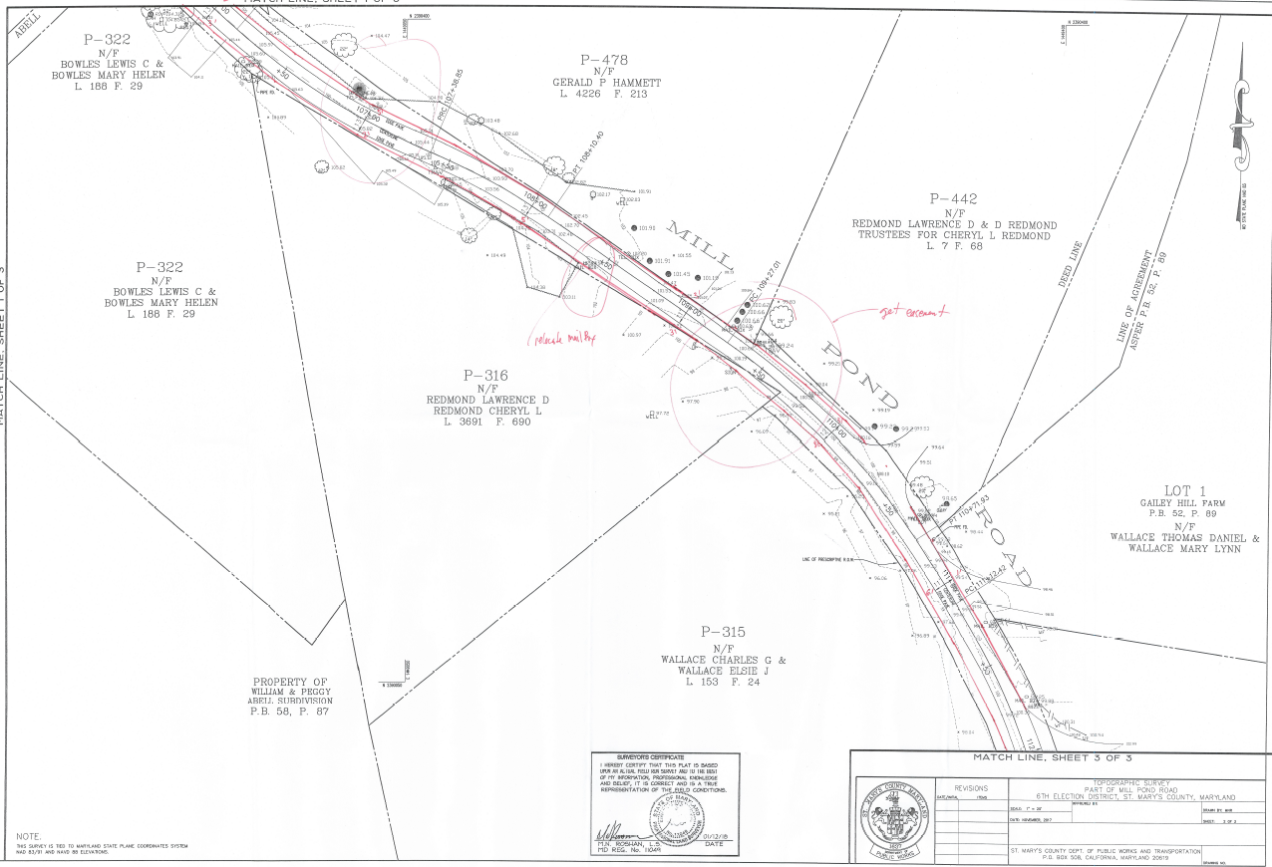

Slide 11
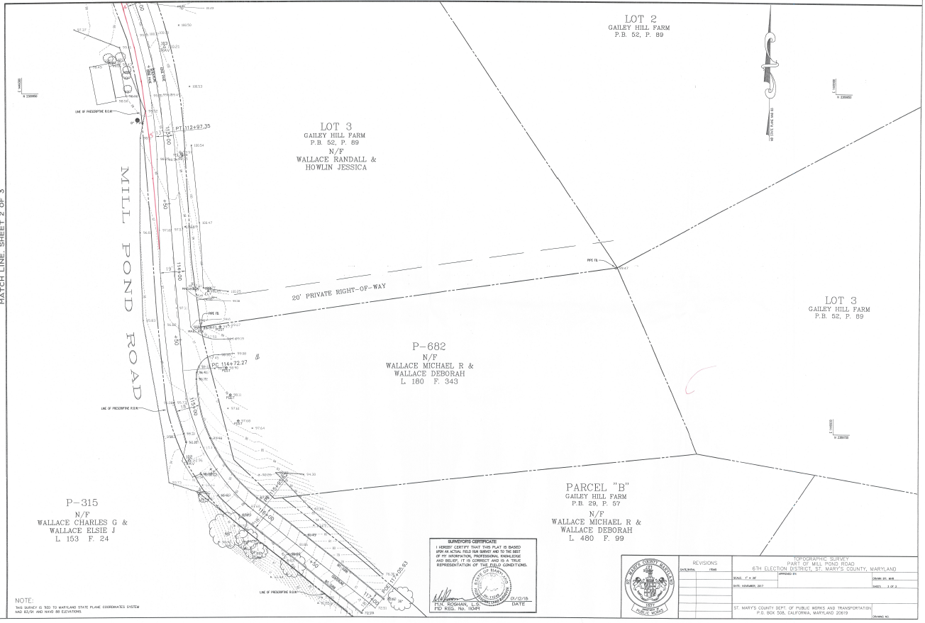

Slide 12
Mill pond road - other options
If widening the road is not acceptable to everyone involved, would pull-off areas be an option? This may allow vehicles to pass one another without running off the pavement.
Pull-off would be placed to where adequate sight distance for safety reasons.
Pull-off areas could be strategically placed along the road which could also minimize the amount of land needed to effectively provide a safer condition.
Pull-off may reduce the need for utility relocation which would help to maintain electrical and communication connectivity to the residents.

Slide 13
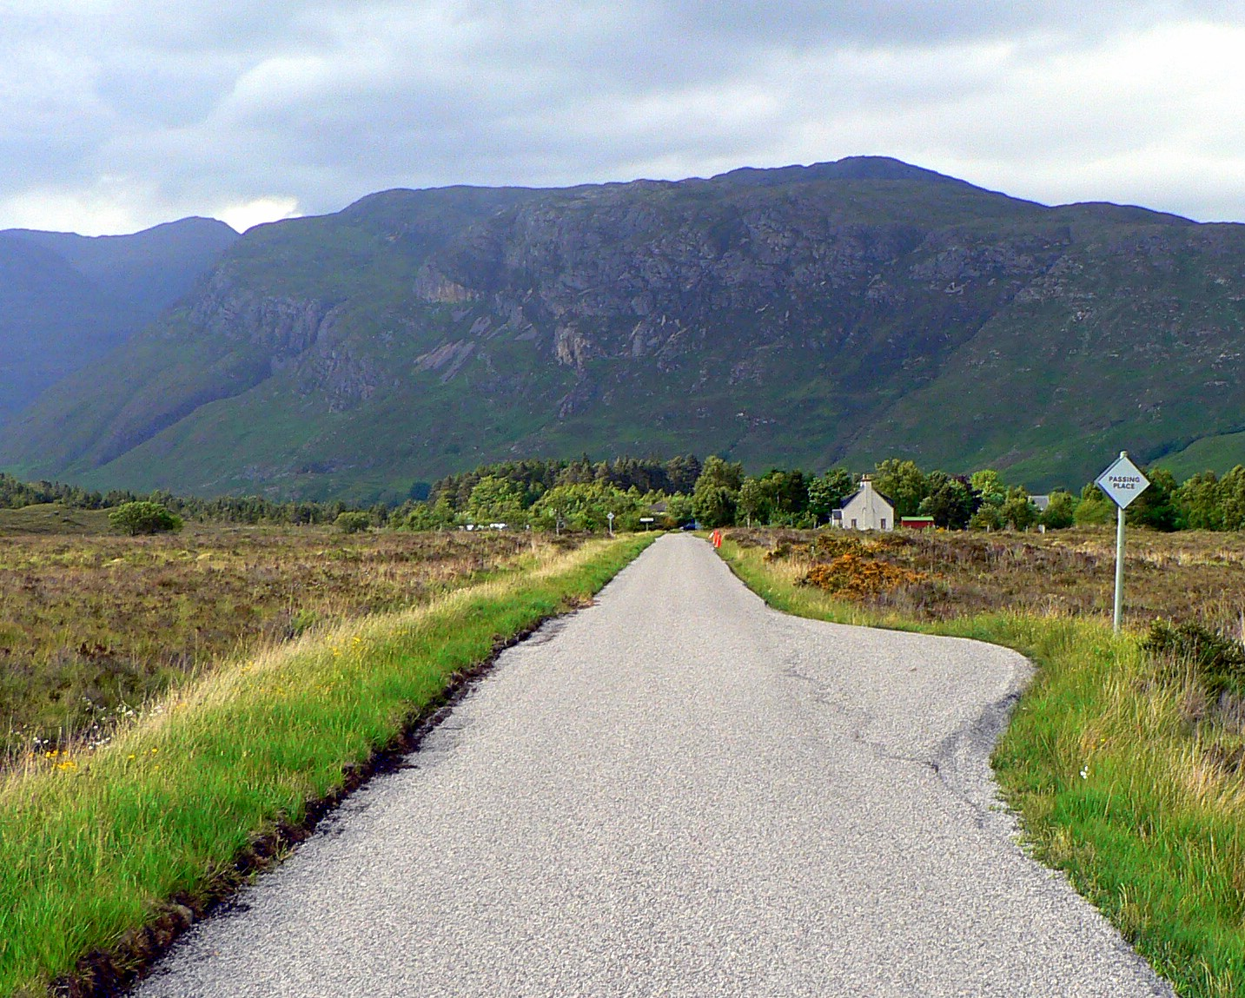
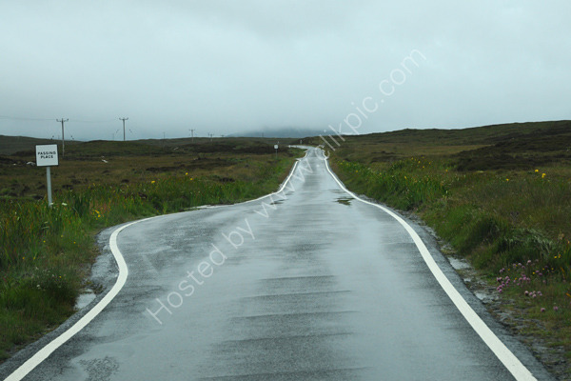
Examples of pull-off areas

Slide 14
Mill pond road financial impact
In widening or providing pull-off on this road, there are costs that need to be considered.
The projected scope could drastically change the cost of construction.
This project will be an improvement for all the property owners that utilize this road as access.
We need input and support from the residents to help make the project a reality.
We are planning to fund the project via the Capital Project HW2101 (Roadway & Safety Improvements) but developing a Special Taxing District has not been ruled out to off-set the cost of improving the road.

Slide 15

Goals/Objectives
Obtain a definitive scope for the project.
Determine property owner’s support for the project.
Minimize utility relocations and disruption of service.
Identify the areas easement and property acquisitions.
Preservation of the Historic Landmark (Wallace Residence).
Provide drainage improvements that correct existing conditions as well as accommodating the road widening portion.
Complete a road widening project that creates a safe environment for motorists and pedestrians.
In closing if we work together, we can reach a goal that will improve Mill Pond Road for the future and amenable for the landowners along the roadway.

